Slide 1

Spider robot model
School Name – s.v.m sinidih
By
Harshit Pathak 8 ‘B’
And
Rounak Vishwakarma 8 ‘B’

Slide 2

Hi! My name is Agent spidy 1 21.
I am created by Rounak and Harshit.
I am a spider robot pet.
I can dance, I can walk, And I can be your pet friend.
Let’s Know about me

Slide 3

My Components:-
Arduino Nano board
Arduino Nano I/O Expansion Board
Servo Motors 12 piece
Bluetooth module HC-05
Jumper cable
9 volt Battery
3d printed structure
Led light 2 piece
9. And my Jarvis code

Slide 4

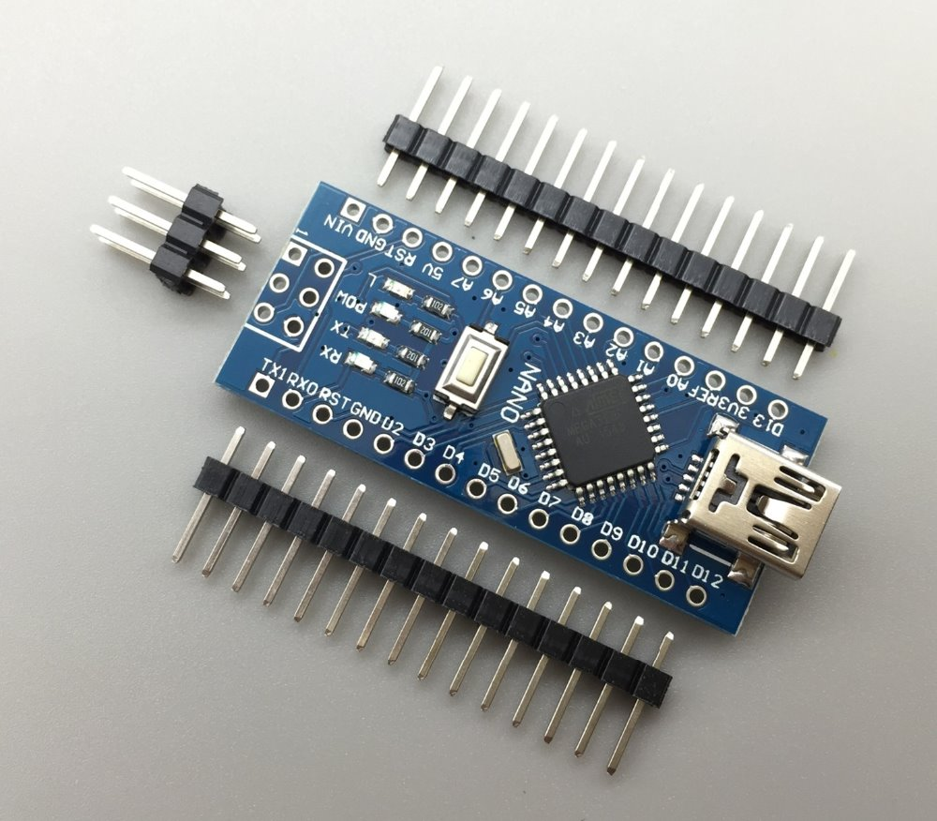
Lets briefly Know about some components:-
Arduino nano – The Arduino Nano is a small, complete and breadboard friendly board based on the ATmega328P microchip released in 2008. The board is equipped with sets of digital and analog Input/Output (I/O) pins that may be interfaced to various expansion boards (shields) and other circuits. The board has 14 digital I/O pins, (six capable of PWM output), 6 analog I/O pins, and is programmable with the Arduino IDE (Integrated Development Environment), via a type-B mini-USB cable.

Slide 5

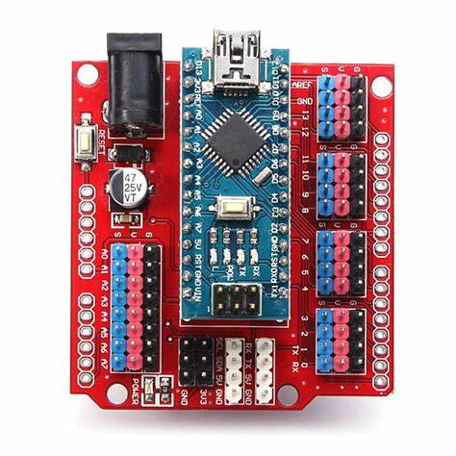
.
2. Arduino nano I/O expansion board :- It is an expansion shield for Arduino
Nano. That provides 14 I/O pin (servo type with GND, power and signal) 8
Analog pin with power output and GND, 6 PWM pin for servo, pin 1 servo
input, 12C Expansion pin. It is basically for connect servo pin easily.

Slide 6

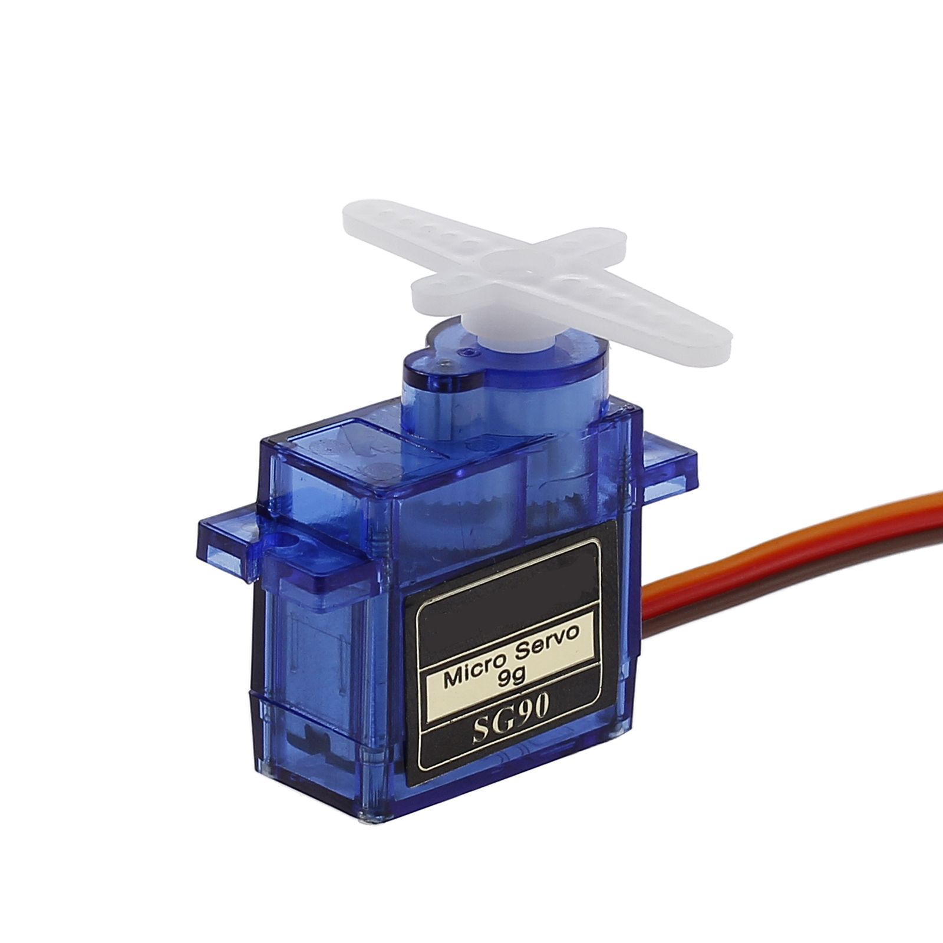
3. Servo motor :- Servo motors are part of a closed-loop system and are
Comprised of several parts namely a control circuit, servo motor, shaft,
Potentiometer, drive gears, amplifier and either an encoder or resolver.
The output shaft of this motor can be moved to a particular angle, position
And velocity that a regular motor does not have. The servo motor utilizes a
Regular motor and couples it with a sensor for positional feedback. The
Motor is controlled with an electric signal, either analog or digital, which
Determines the amount of movement which represents the final command
Position for the shaft. Basically it is for my movement.

Slide 7

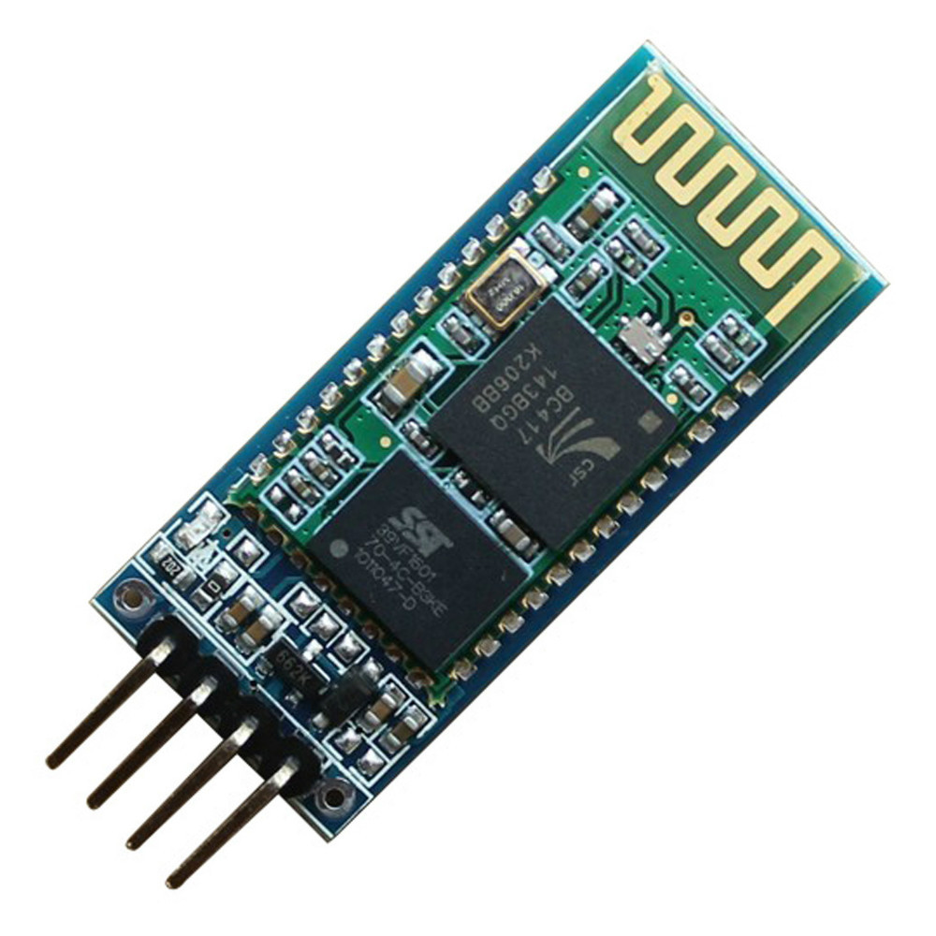
4. Bluetooth Module HC-05 :- HC-05 is a Bluetooth module which is designed
For wireless communication. It is used for many applications like wireless
Headset, game controllers, wireless mouse and many more. It range up to
<100m. It is for control me with smart phone.

Slide 8

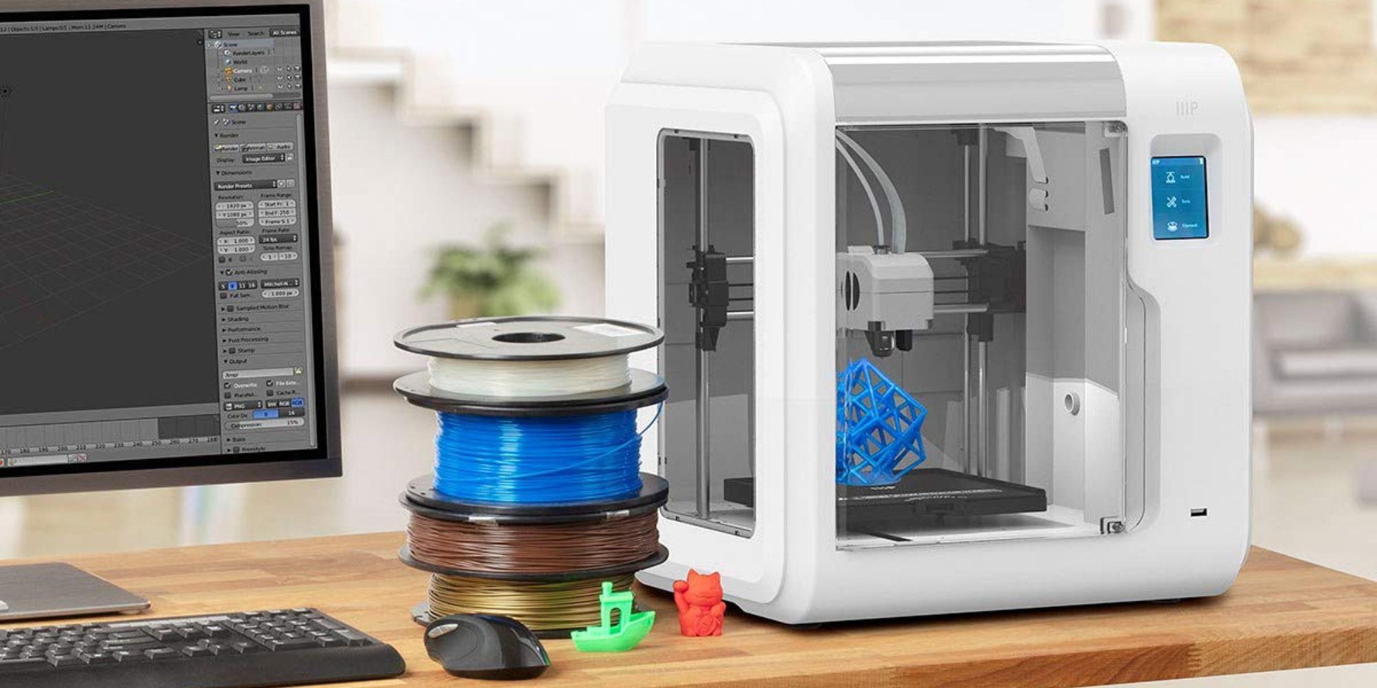
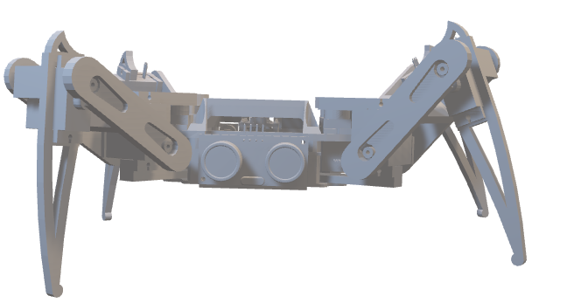
5. 3d printed structure :- It is my structure. Which is printed with a
3d printer. It is a three dimensional printer.

Slide 9

6. And the last one is my Jarvis that is made in python programming
Language By Rounak. It helps me to speak.

Slide 10







Our Resources

Slide 11


